Slide 1
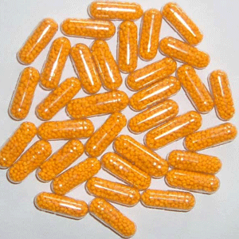
Take your vitamins to fight Hepatitis C Virus
Anna Wakeland
BIOM 253
6/1/11

Slide 2
Outline
Hepatitis C background information
Current therapies & treatment
Rationale & strategy for novel treatment idea
Advantages & potential problems
Development & manufacturing

Slide 3
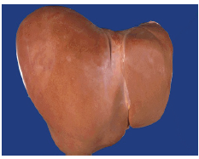
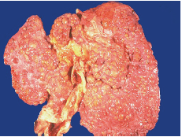
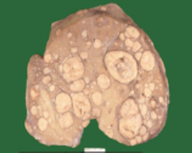
Background
Hepatitis C Virus (HCV)
6 genotypes
Mutates rapidly due to high error rate of HCV’s RNA-dependent RNA polymerase
Affects ~2-3% (>130 million) of the world population
  20% acute hepatitis
  80% chronic hepatitis
  Can lead to cirrhosis and hepatocellular carcinoma
Normal

Slide 4
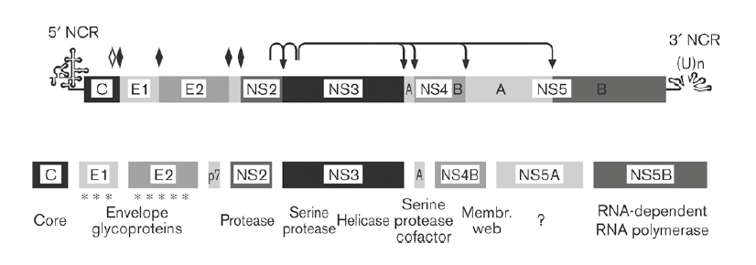
HCV Polyprotein Processing
Hepatitis C virus (HCV) encodes a single polyprotein, which is processed by cellular and viral proteases to generate 10 polypeptides.
Notes:
The 9.6 kb positive-strand RNA genome is composed of a 5′ non-coding region (NCR), a long open-reading frame encoding a polyprotein precursor of about 3000 amino acids, and a 3′ NCR. The polyprotein precursor is processed into structural and non-structural proteins by cellular and viral proteases. Solid diamonds denote cleavage sites of the endoplasmic reticulum signal peptidase. The open diamond indicates further C-terminal processing of the core protein by signal peptide peptidase. Arrows indicate cleavages by HCV NS2-3 and
NS3 proteases. Asterisks in the E1 and E2 region indicate glycosylation of the envelope proteins

Slide 5
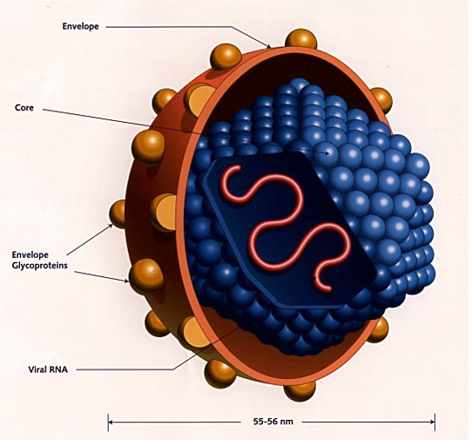
Structure of HCV
Envelope
Core
Envelope glycoproteins
Viral RNA
55-56 nm

Slide 6
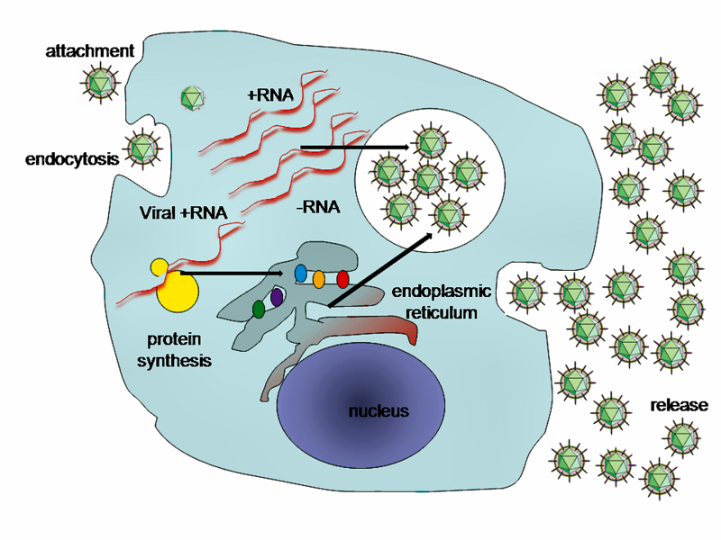
Replication of HCV
Notes:
Replication occurs mainly in hepatocytes. HCV takes over portions of the intracellular machinery to replicate.^{[8]} The HCV genome is translated to produce a single protein of around 3011 amino acids. The polyprotein is then proteolytically the structural and nonstructural (NS) proteins. The NS proteins then recruit the viral genome into an RNA replication complex, RNA replication takes places via the viral RNA-dependent RNA polymerase NS5B, which produces a negative-strand RNA intermediate. The negative strand RNA then serves as a template for the production of new positive-strand viral genomes. Nascent genomes can then be translated, further replicated, or packaged within new virus particles. New virus particles are thought to bud into the lipoprotein secretory pathway and are released at the cell surface

Slide 7
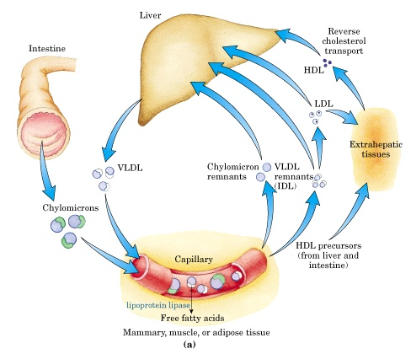
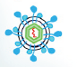
Lipoproteins and lipid transport
HCV coats itself with lipoproteins to attach to the LDL receptor
Evidence suggests HCV utilizes host VLDL secretory pathway (Andre et al. J. Virol 2002)
Notes:
Major lipoproteins are chylomicrons, VLDL, LDL and HDL
Chylomicrons in capillaries of mammary, muscle or adipose tissue are turned into FFAs by lipoprotein lipase, which will be consumed or stored as fuel. When body has more Fatty acids than needs, they are converted to TAGs in the liver and packaged into VLDL. Further removal of TAGs from VLDL produces LDL, which carry cholesterol to extrahepatic tissues.

Slide 8
Current Therapies
Ribavirin and Interferon: effective in ~50%, can cause significant side effects
Antivirals
  Several compounds are in clinical trials-directed against NS3 protease, viral polymerase (NS5b) and NS5A
Vaccine
  Due to high mutation rates resulting in quasispecies leading to immune escape no vaccine in sight yet (unlike Hepatitis A and B)

Slide 9
Rationale for new strategy
Compounds and dietary supplements that influence lipoprotein metabolism might also affect HCV
Ex. grapefruit flavonoid naringenin (reduces plasma cholesterol and triglyceride levels) found to reduce HCV secretion
Problems: intestinal wall does not absorb it well, significant drug-drug interactions
Try something else
http://www.endonurse.com/news/2008/05/grapefruit-flavonoid-inhibits-hepatitis-c.aspx

Slide 10
Strategy: Interfere with VLDL/HCV interaction
Statins are already being used to treat HCV, but have less effect at lowering triglycerides and raising HDL than other compounds
Niacin (Vitamin B3) is one such compound
Notes:
Niacin blocks the breakdown of fats in adipose tissue. These fats are used to build very-low-density lipoproteins (VLDL) in the liver, which are precursors of low-density lipoprotein (LDL) or "bad" cholesterol. Because niacin blocks the breakdown of fats, it causes a decrease in free fatty acids in the blood and, as a consequence, decreases the secretion of VLDL and cholesterol by the liver.^{[12]} By lowering VLDL levels, niacin also increases the level of high-density lipoprotein (HDL) or "good" cholesterol in blood

Slide 11
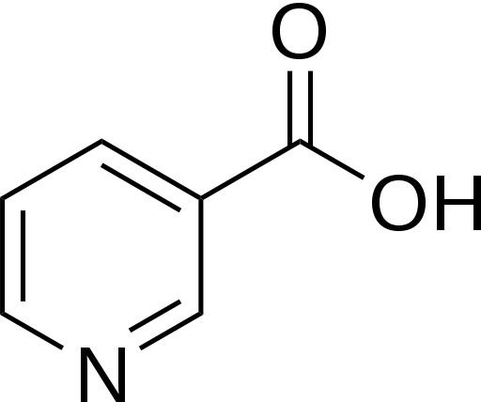
Niacin (Vitamin B3)
The liver can synthesize niacin from tryptophan (60 mg Trp = 1 mg Niacin)
Niacin blocks the breakdown of fats in adipose tissue that are used to build VLDL in the liver
Decrease of FFAs in the blood
Decrease secretion of VLDL, increase levels of HDL
Supplement Niacin intramuscularly or orally in doses from ~15 mg/day

Slide 12
Niacin
Advantages
Blocks synthesis of VLDL, which HCV use to “hitch a ride”
Raises HDL, beneficial effects
Relatively cheap
Easy to manufacture
Potential problems
Skin flushing & itching (2-6 g/day)
Body can only absorb so much, and can be toxic in high doses
Can elevate blood sugar
When give to patient?
Notes:
Several million kilograms of niacin are manufactured each year, starting from 3-methylpyridine, main precursor to Niacin
Hard to diagnose HCV in the acute phase b/c no symptoms (detect HCV antibodies in blood)

Slide 13
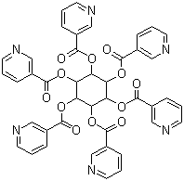
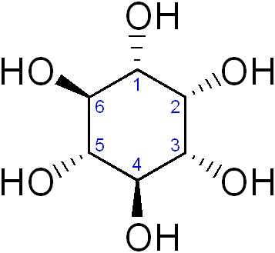
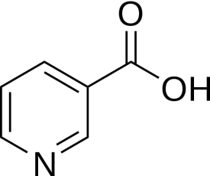
Targeted high-dose delivery
Inositol esterified with Niacin can be given in much higher doses (100-1000 mg) with no flushing and other side effects
Delivery into liver cells via nanoparticle conjugated to specific ligands
Time-released: Niacin can be cleaved off into active form
  Ester bonds are water soluble
+ 6
Inositol
Niacin
Inositol hexanicotinate

Slide 14

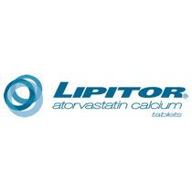


Development and Manufacturing
Notes:
Companies that manufacture statins (Merck makes Mevacor (ie Lovastatin), Lipitor makes atorvastatin)
Vitamin companies (Nature’s Plus, ) that already make Vitamin B3
Valeant makes ribavirin

